Slide 1
Healthy lifestyle analysis for 2021
Stefani Kondić

Slide 2
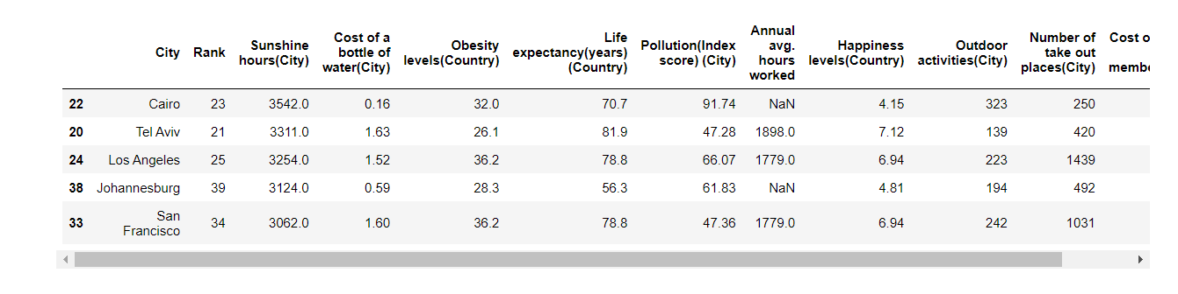
Cities with most sunshine hours

Slide 3
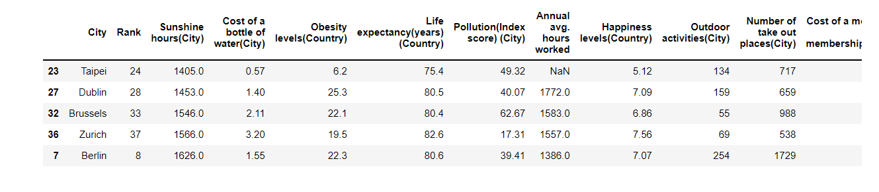
Cities with least sunshine hours

Slide 4
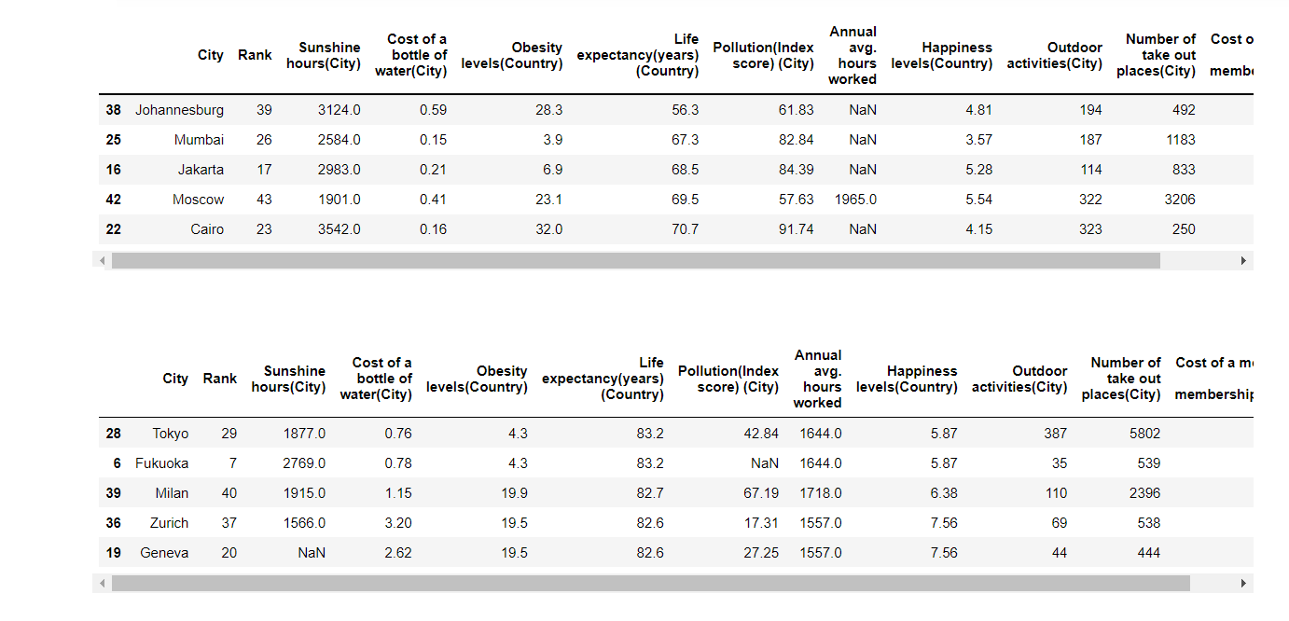
Cities with lowest and highest life expectancy

Slide 5
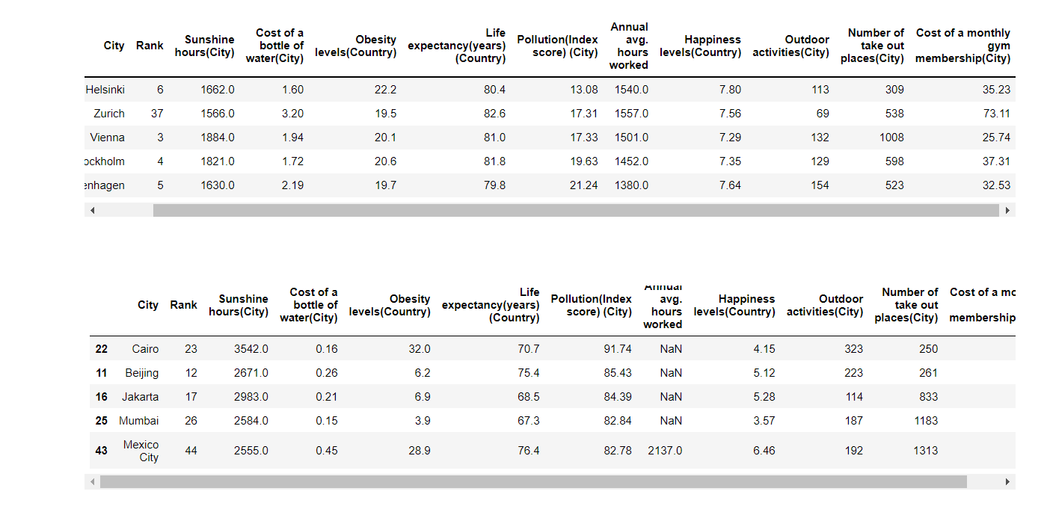
Cities lowest and highest pollution index

Slide 6
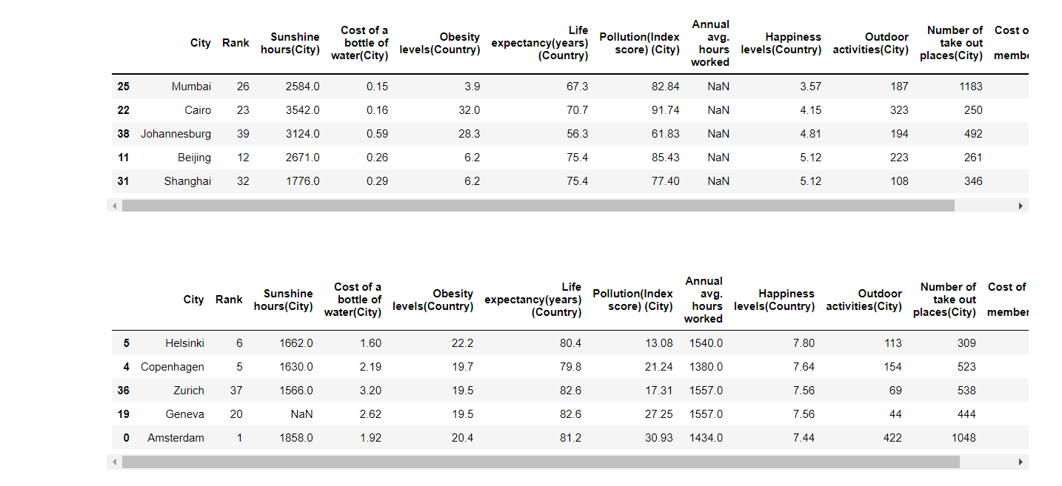
Cities with highest and lowest happiness levels

Slide 7
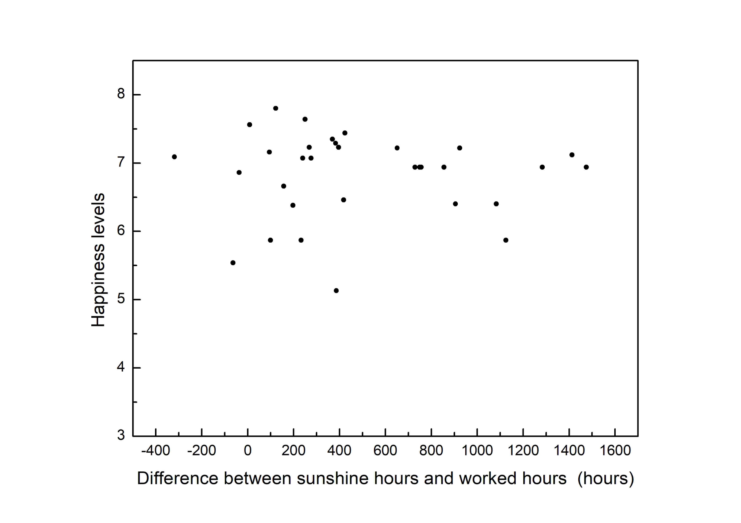
Any correlation of happiness with sunny days?

Slide 8
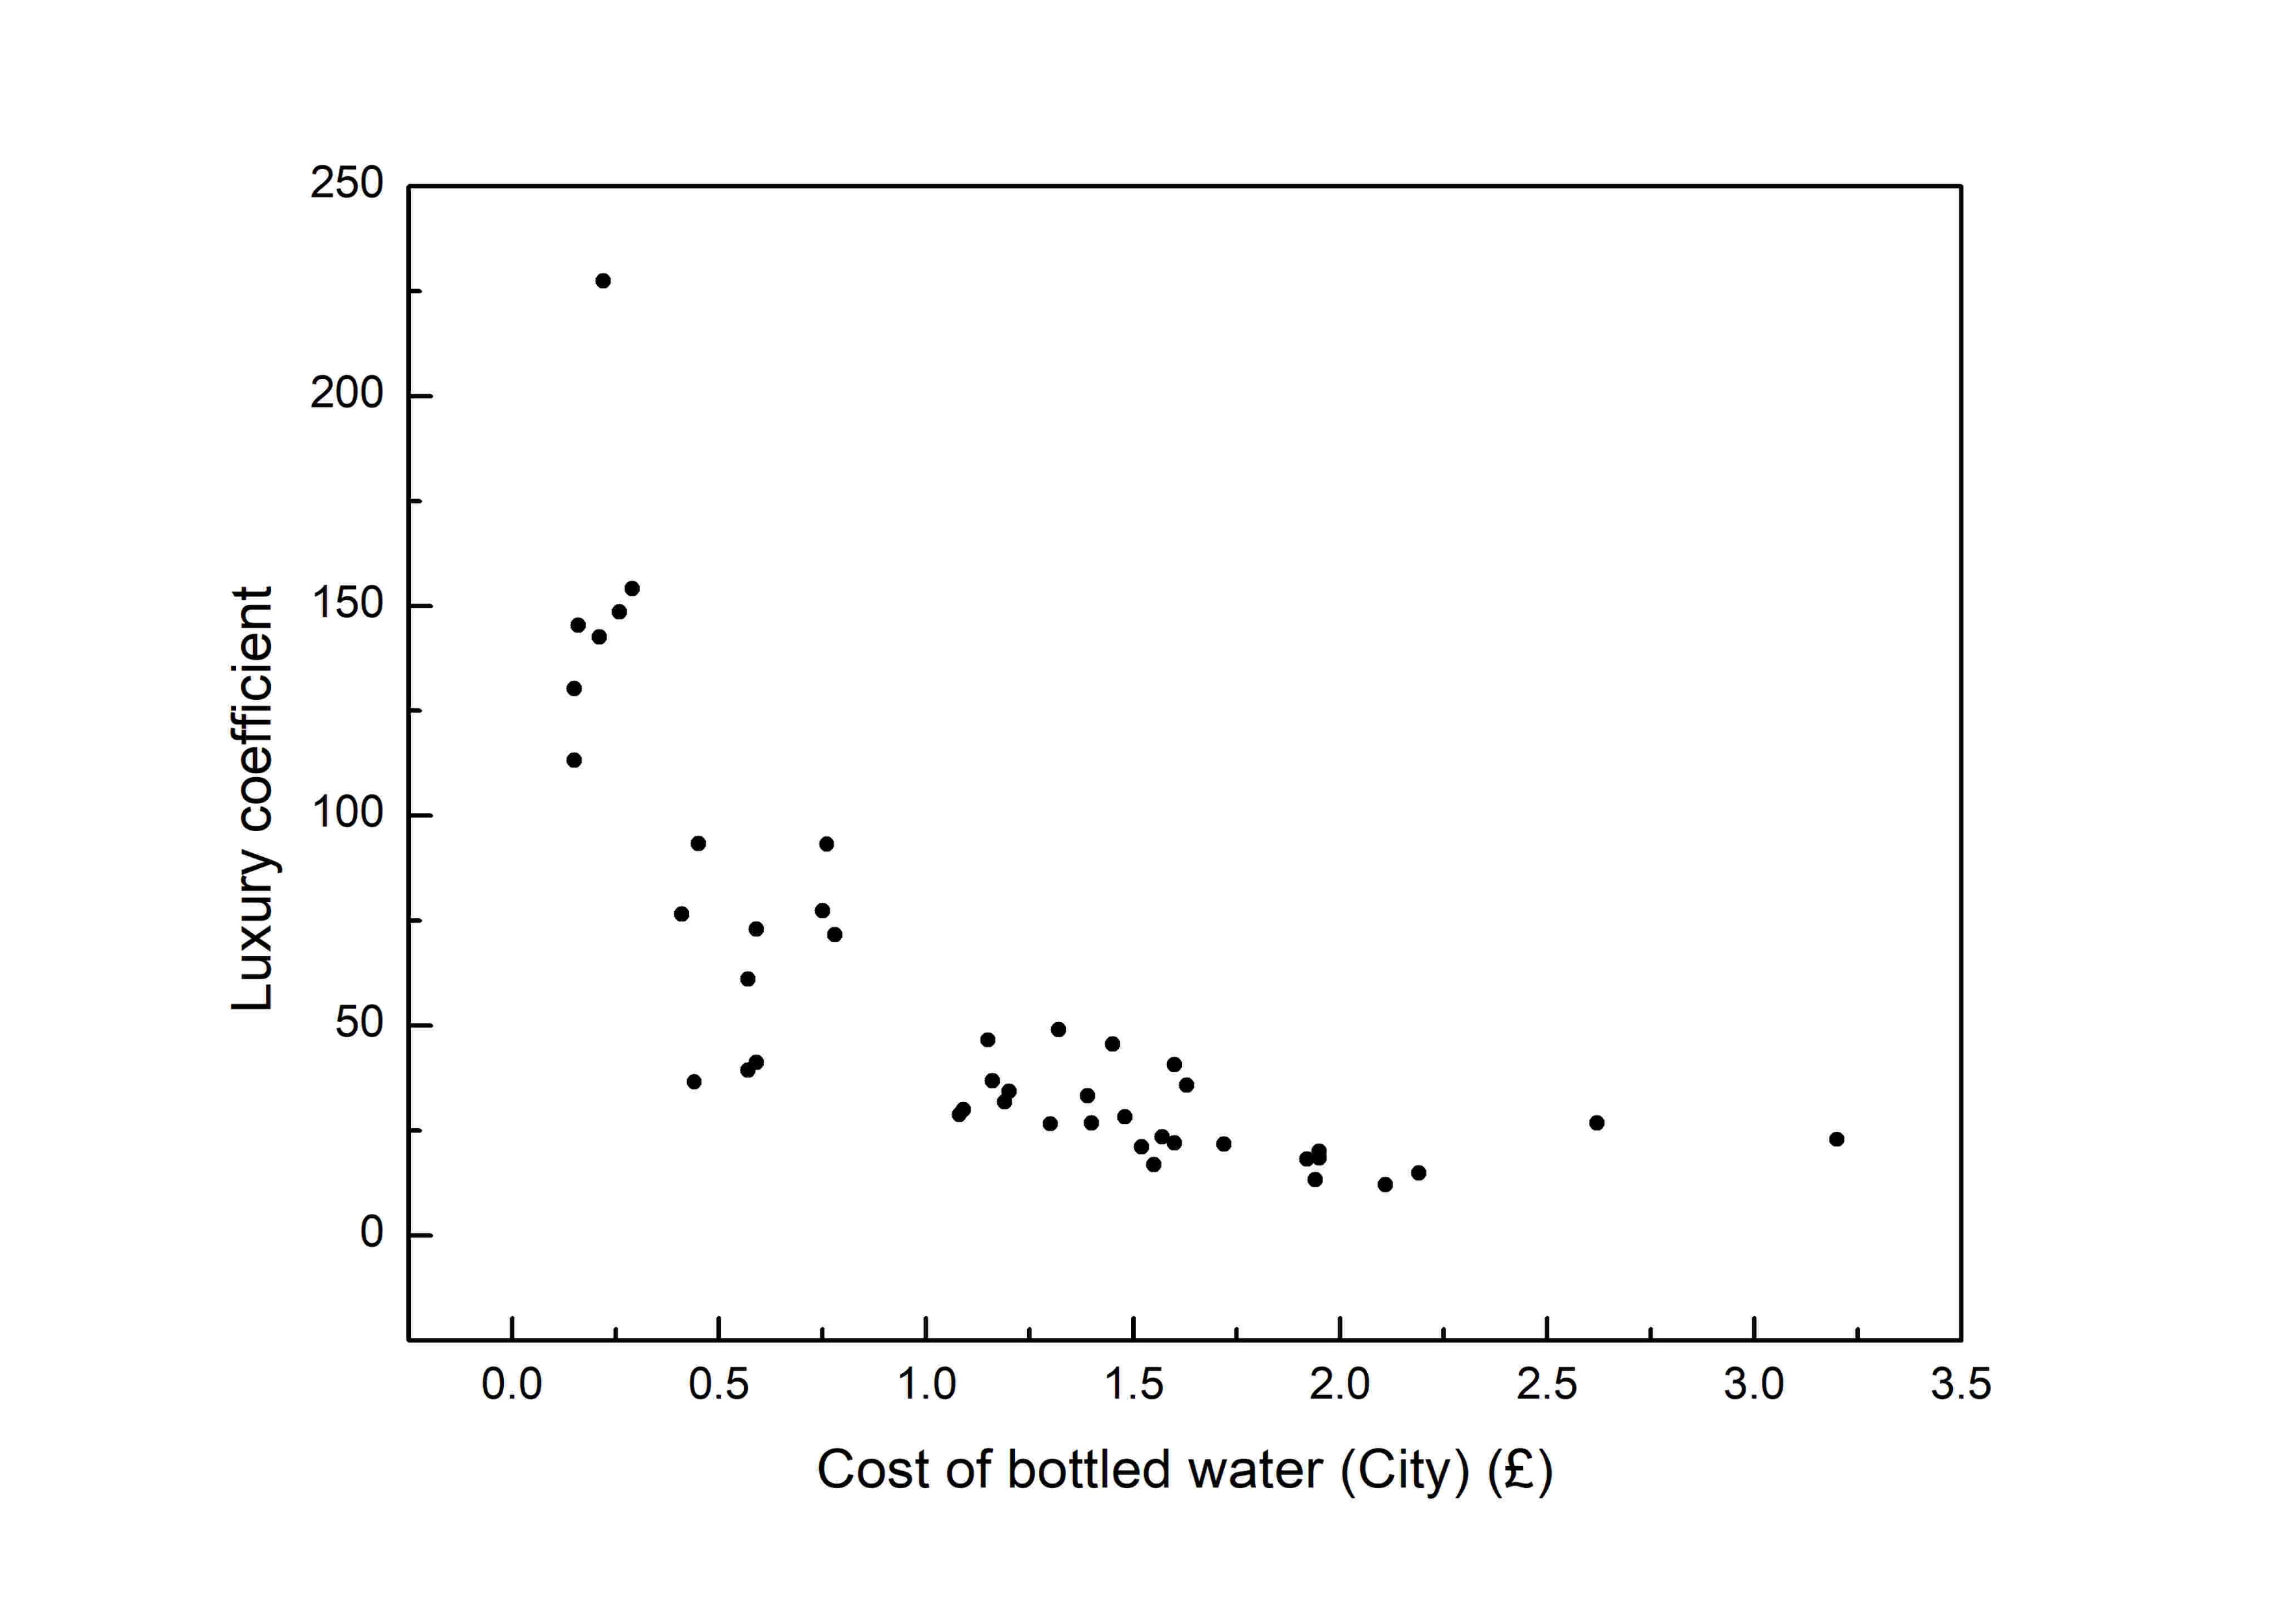
Behavior of difference between classes with respect to standard of life (development of the country)

Slide 9
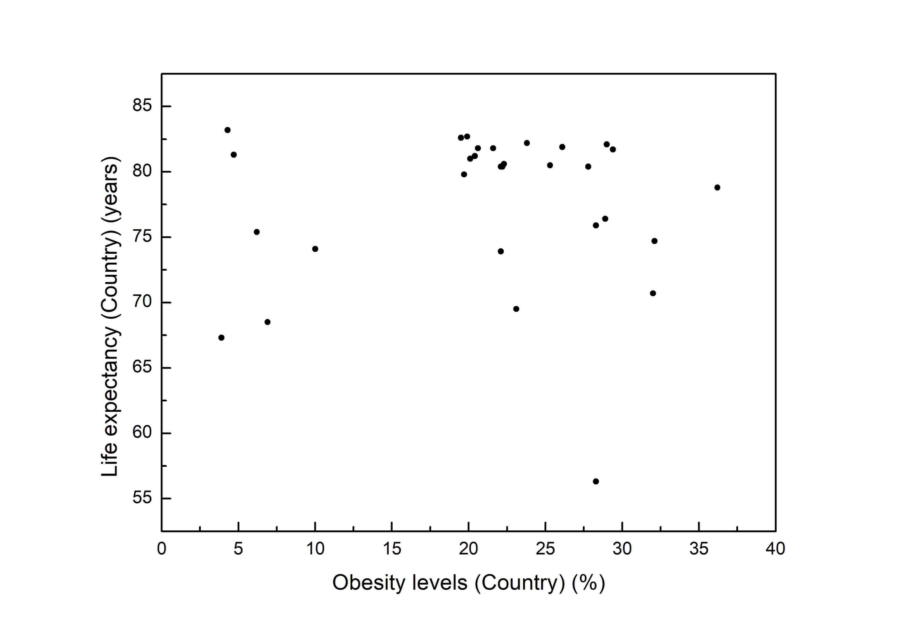
How does obesity – lifespan relationship looks like?

Slide 10
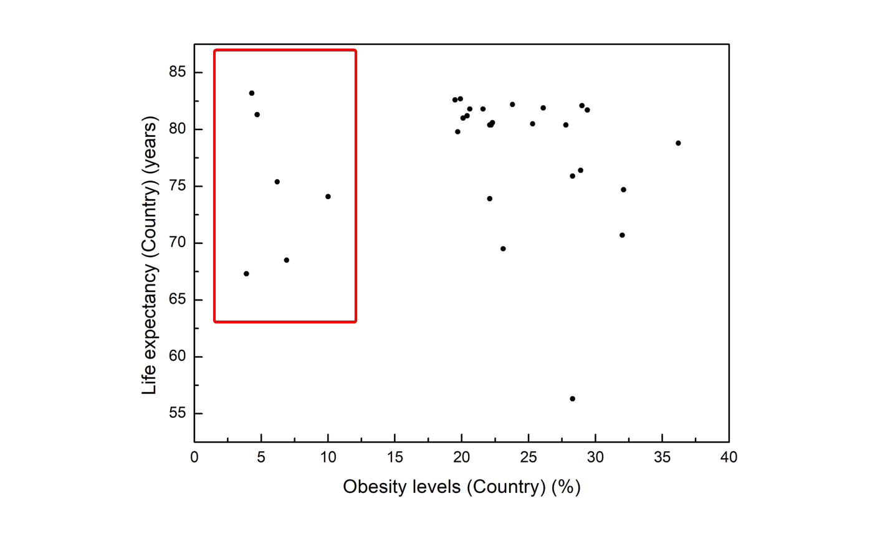

Slide 11
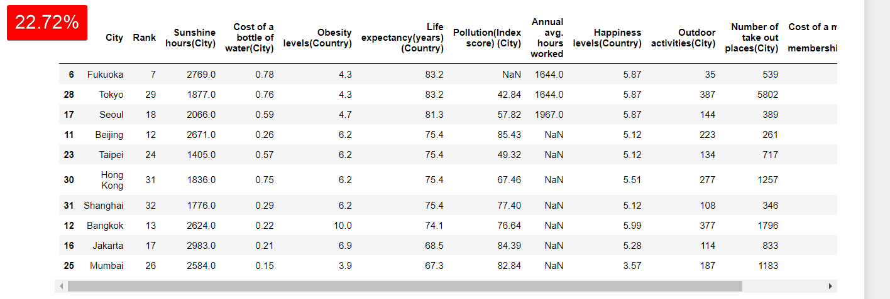
Left side of the graph holds 22.70% of cities

Slide 12
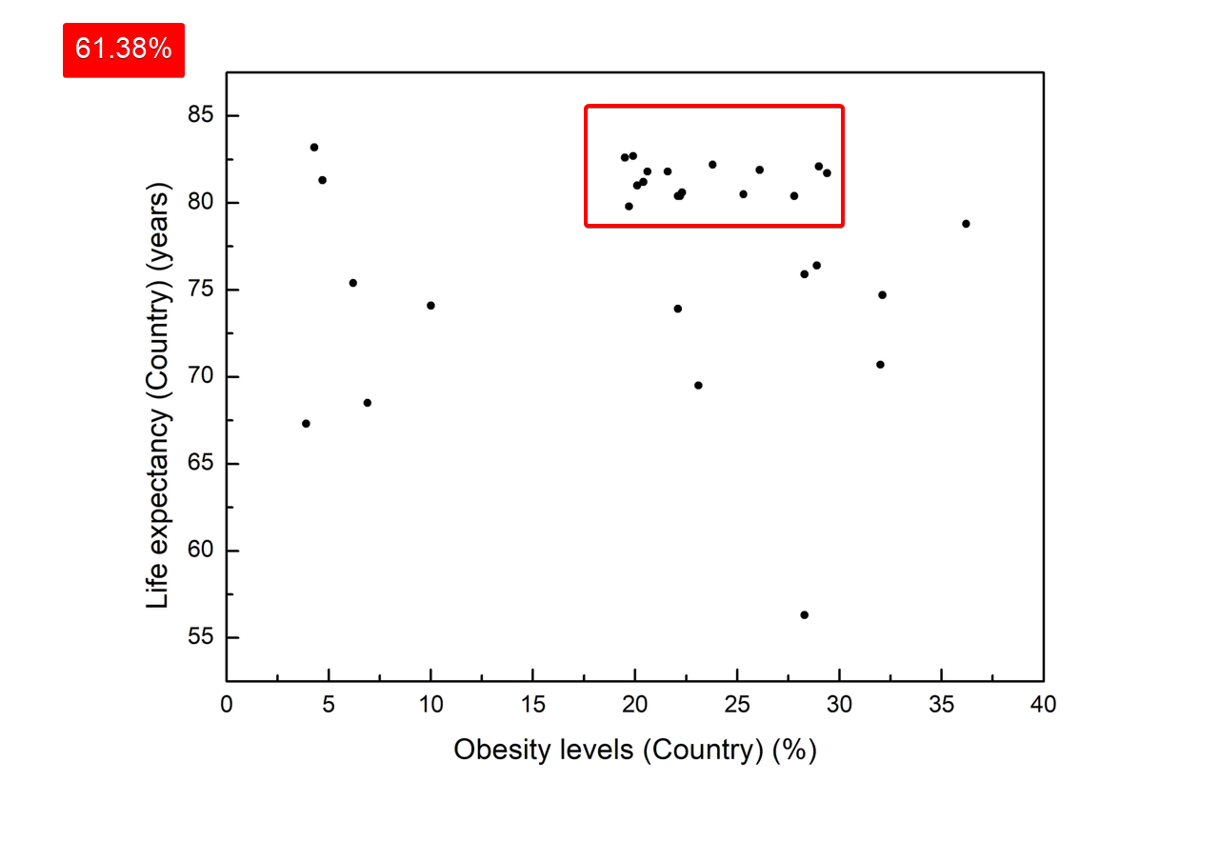

Slide 13
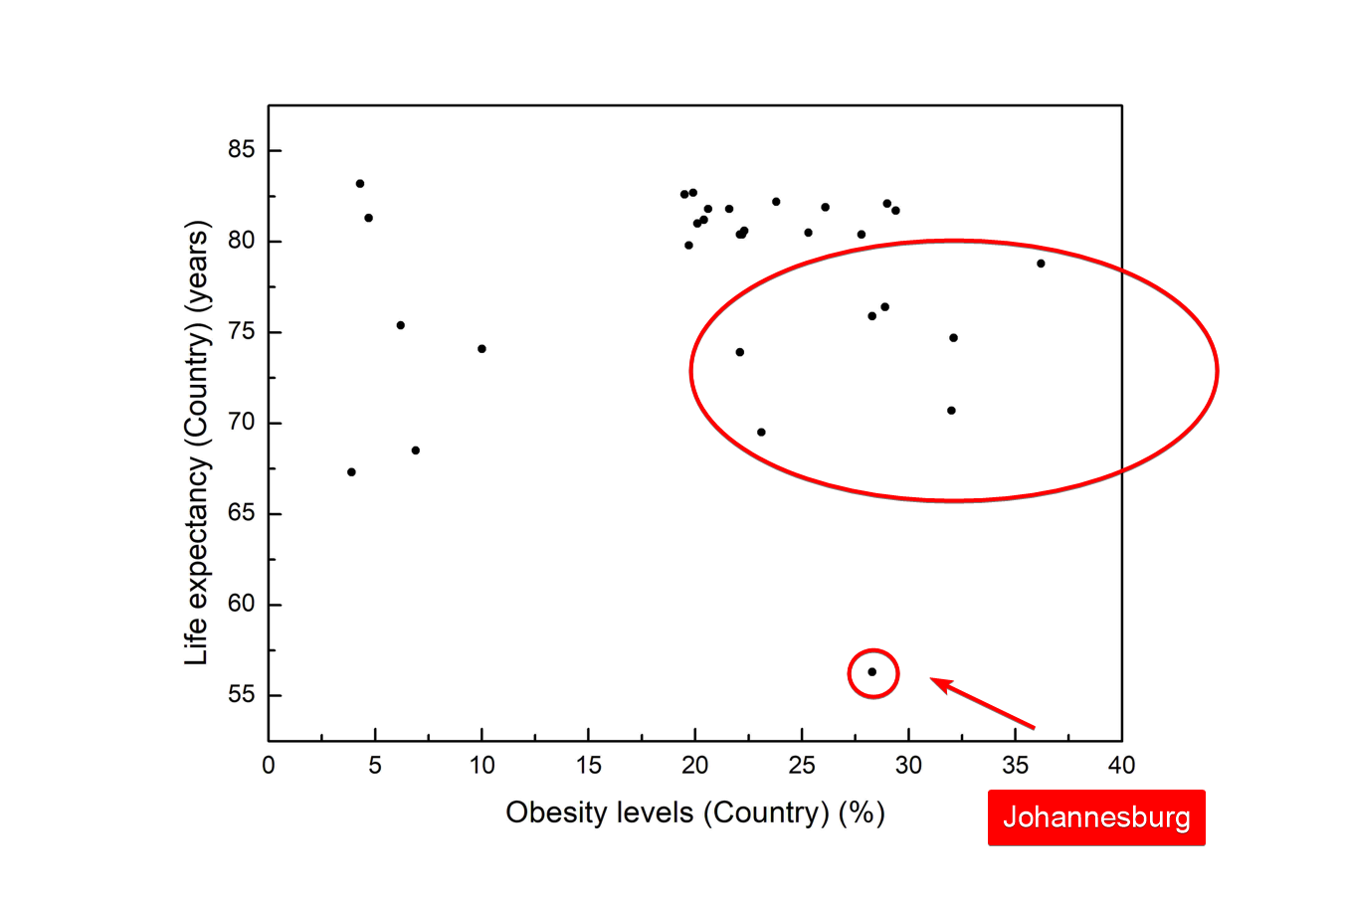

Slide 14
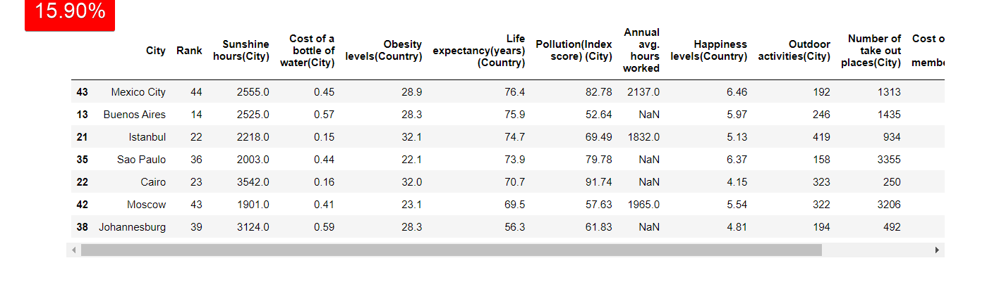

Slide 15
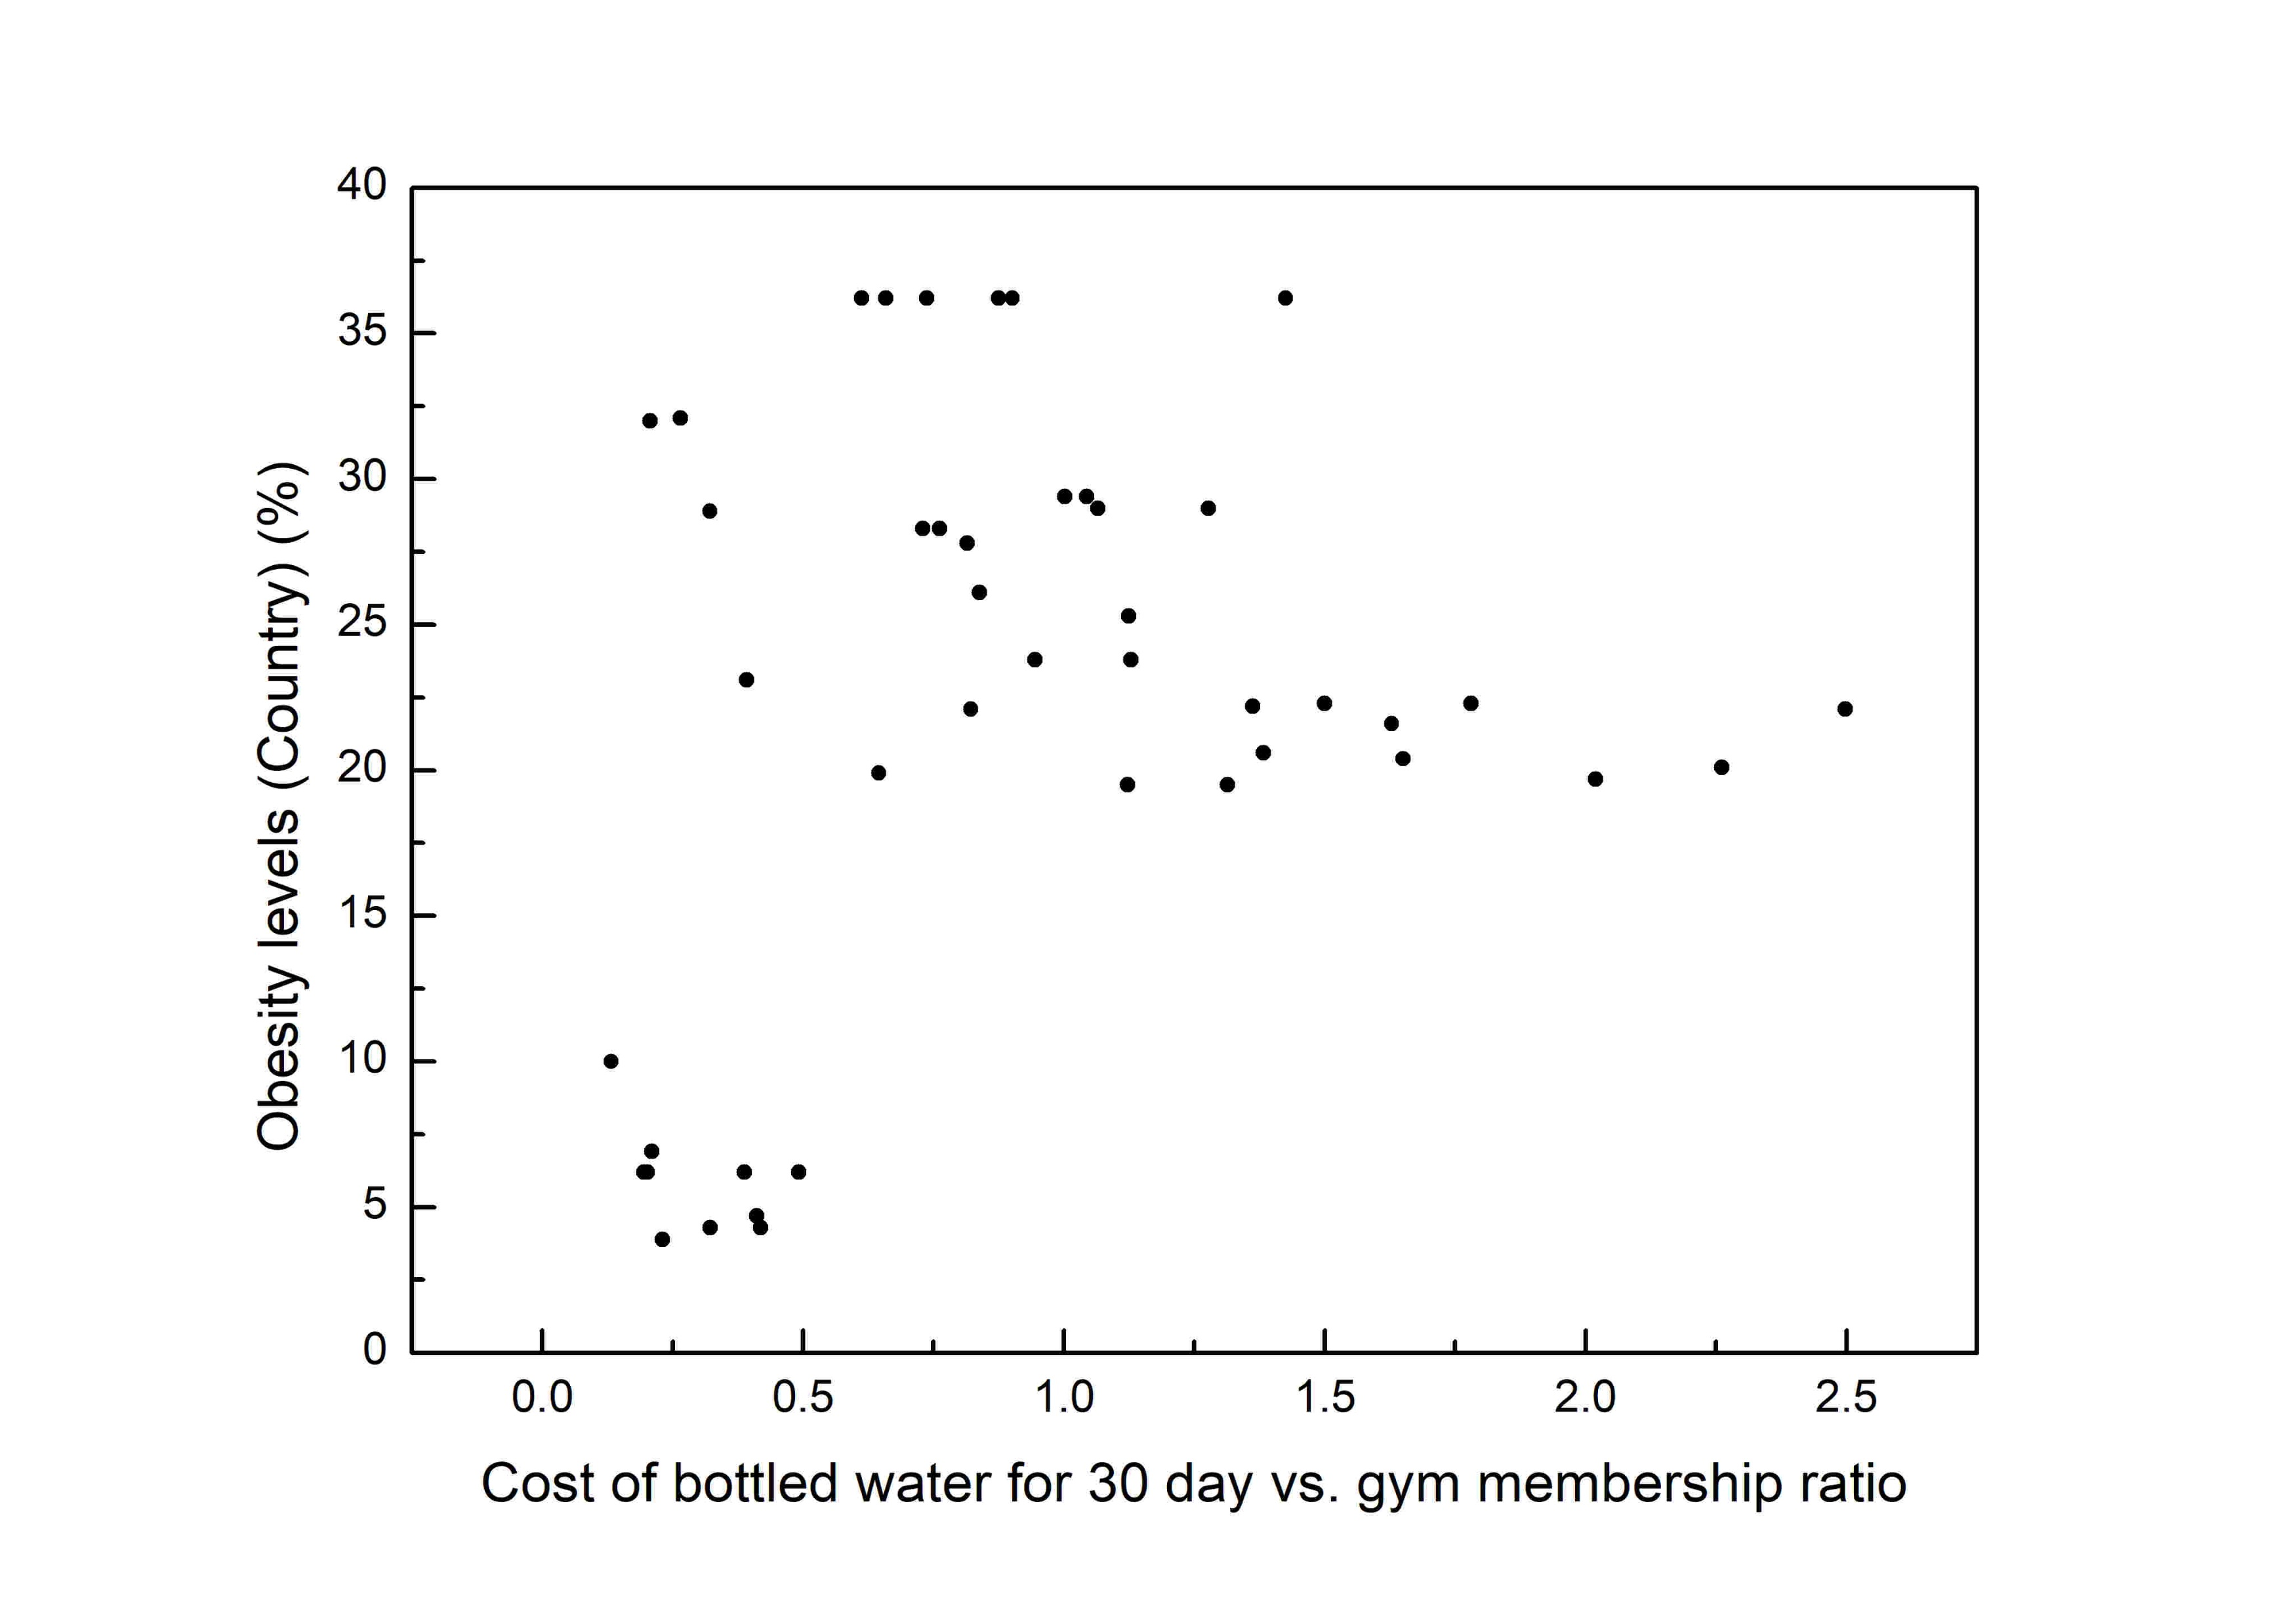
Let's now see relationship between obesity levels and life standard that is now expressed as ratio between cost of monthly gym membership and 30 days of water (buying one per day).

Slide 16
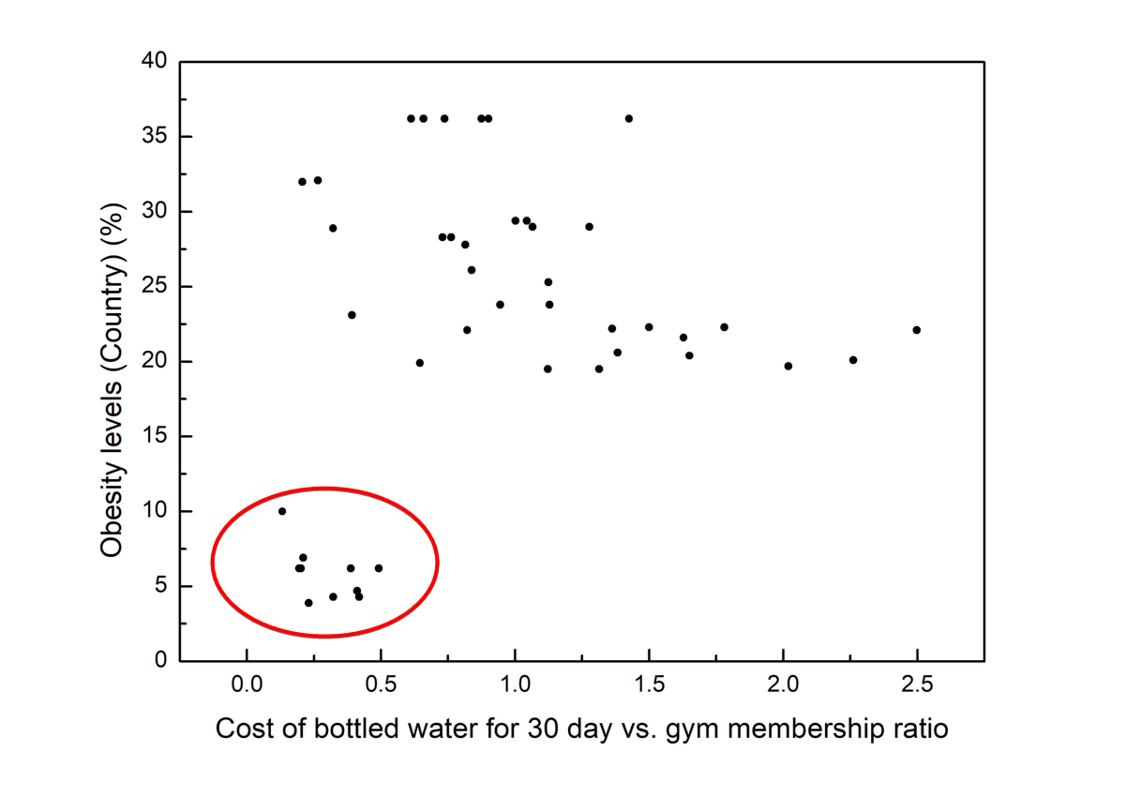
Filtering out

Slide 17
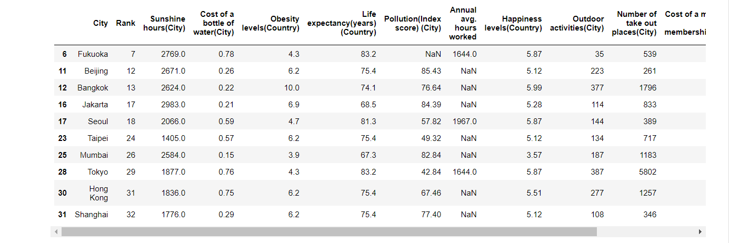
Bottom left corner

Slide 18
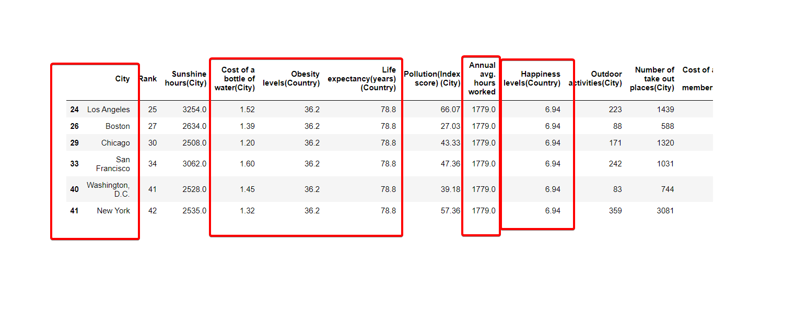
Fun fact: for some reason, countries that have the same obesity level have also the same annual avg. working hours, happiness level, life expectancy and around the same price of bottled water.

Slide 19
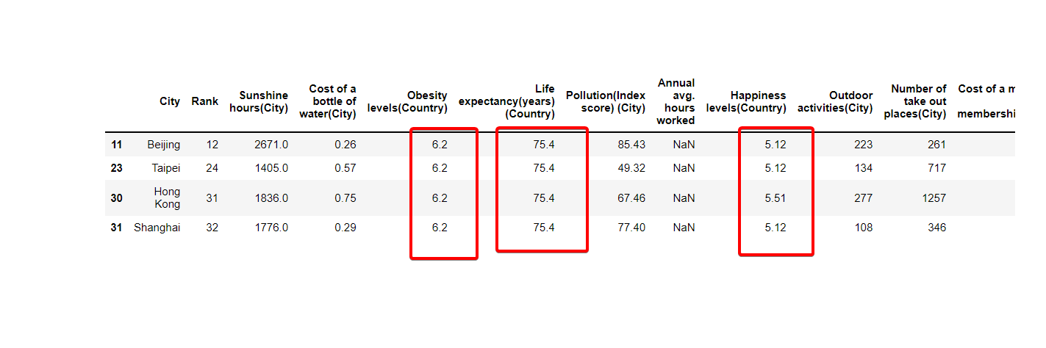

Slide 20
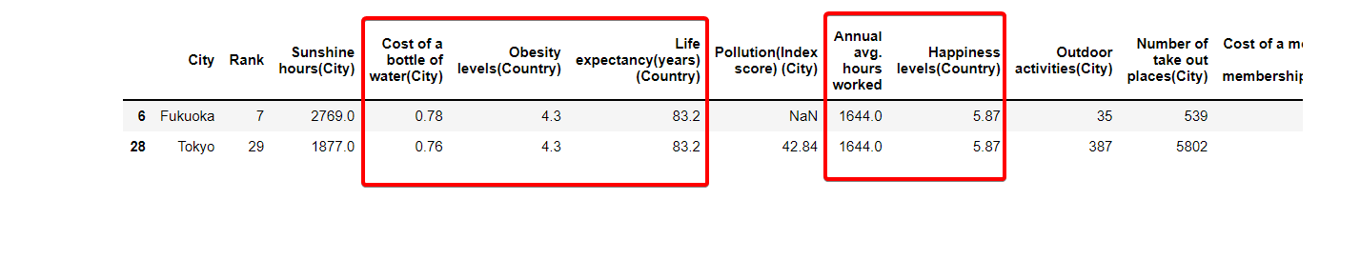

Slide 21
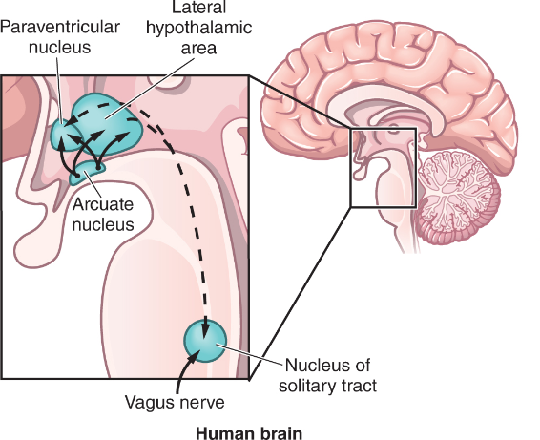
Arcuate nucleus of hypothalamus
It is know that viewing light affects human feeding behavior. There is an aggregation of neurons in hypothalamus (arcuate nucleus of hypothalamus) that drives our feeding behavior and feelings of being safe. So, let's check out the relationship between obesity levels and sunshine hours.

Slide 22
The more sunlight you view, less hungry you will be. There are some particular cells in our eyes that are sensitive to blue light and regulate our circadian rhythm and also feeding behaviors.
We would expect that cities with more sunny hours should have lower obesity levels.

Slide 23
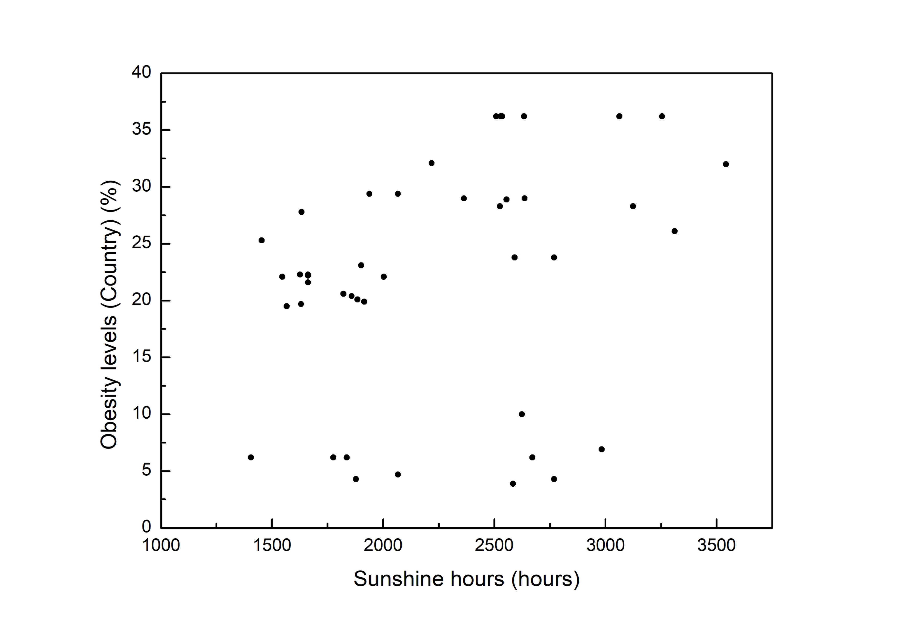
Obesity levels as a function of sunshine hours per year

Slide 24
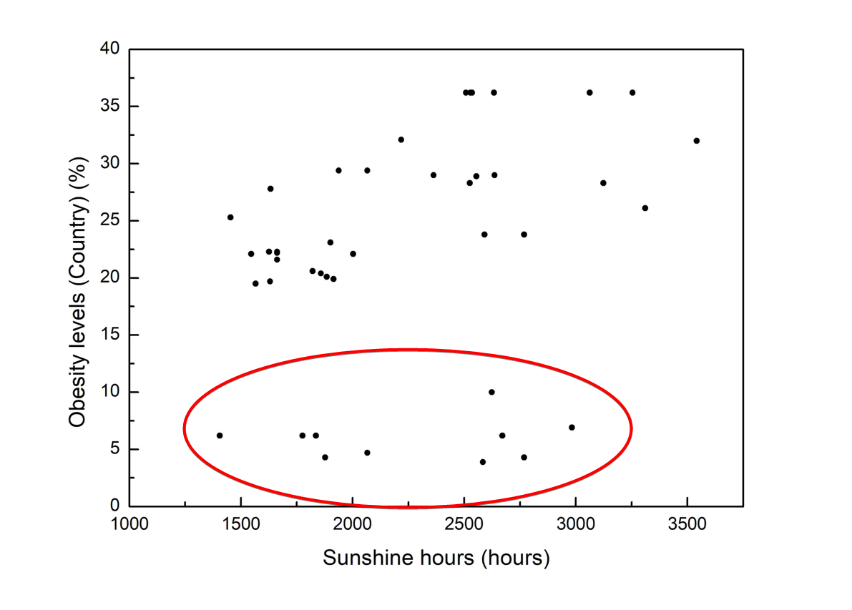

Slide 25
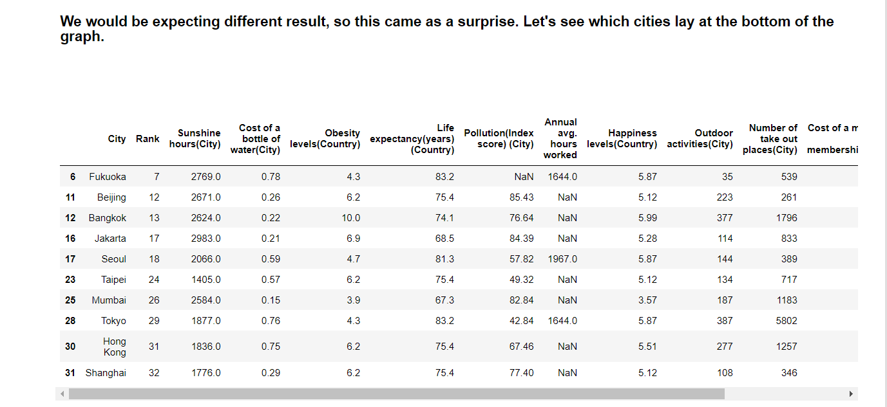

Slide 26
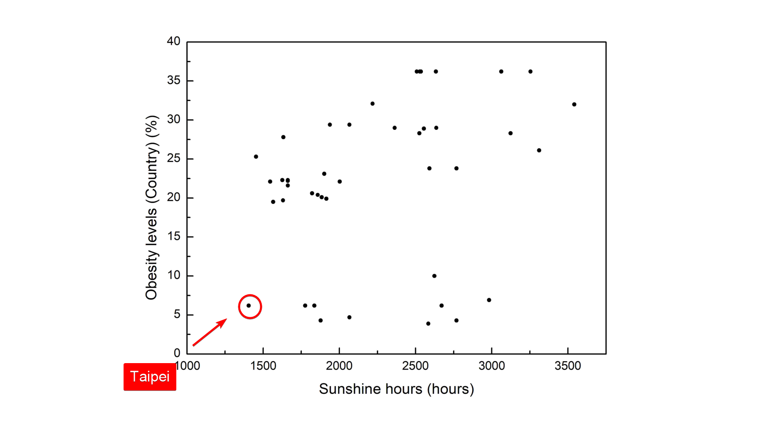

Slide 27
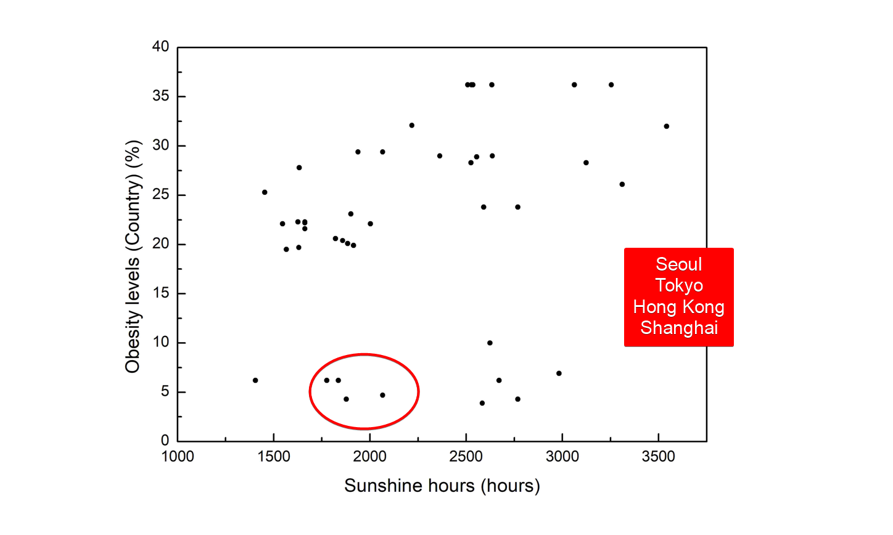

Slide 28
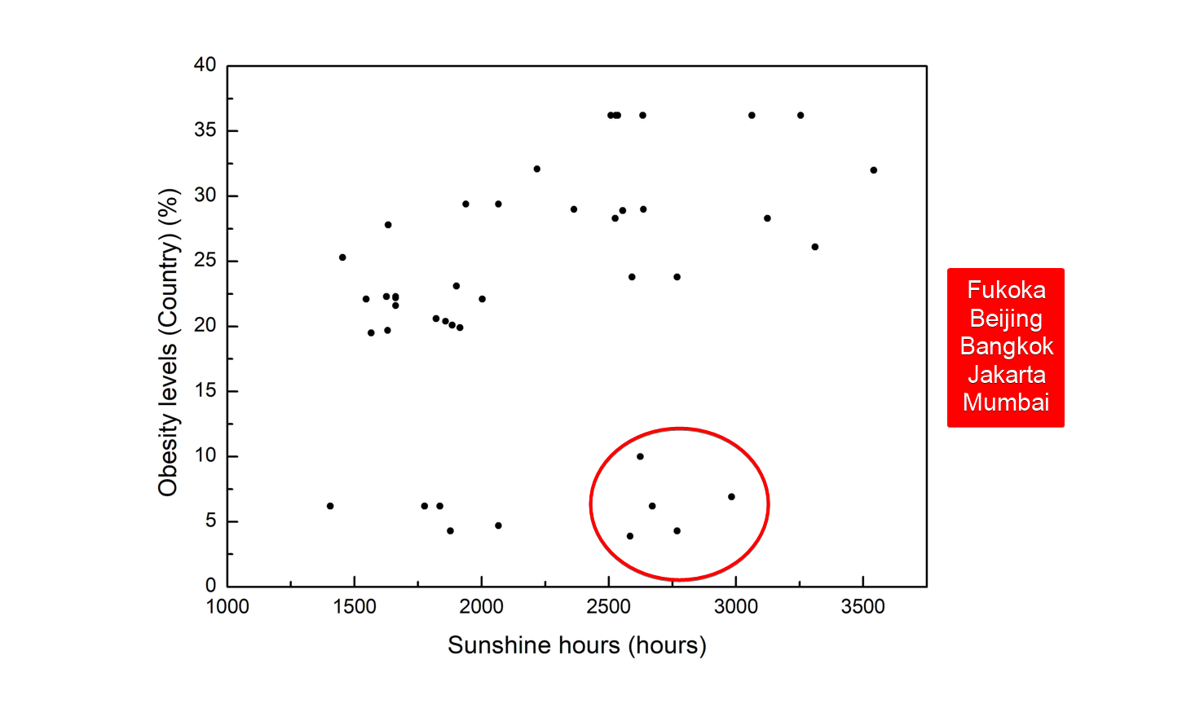

Slide 29
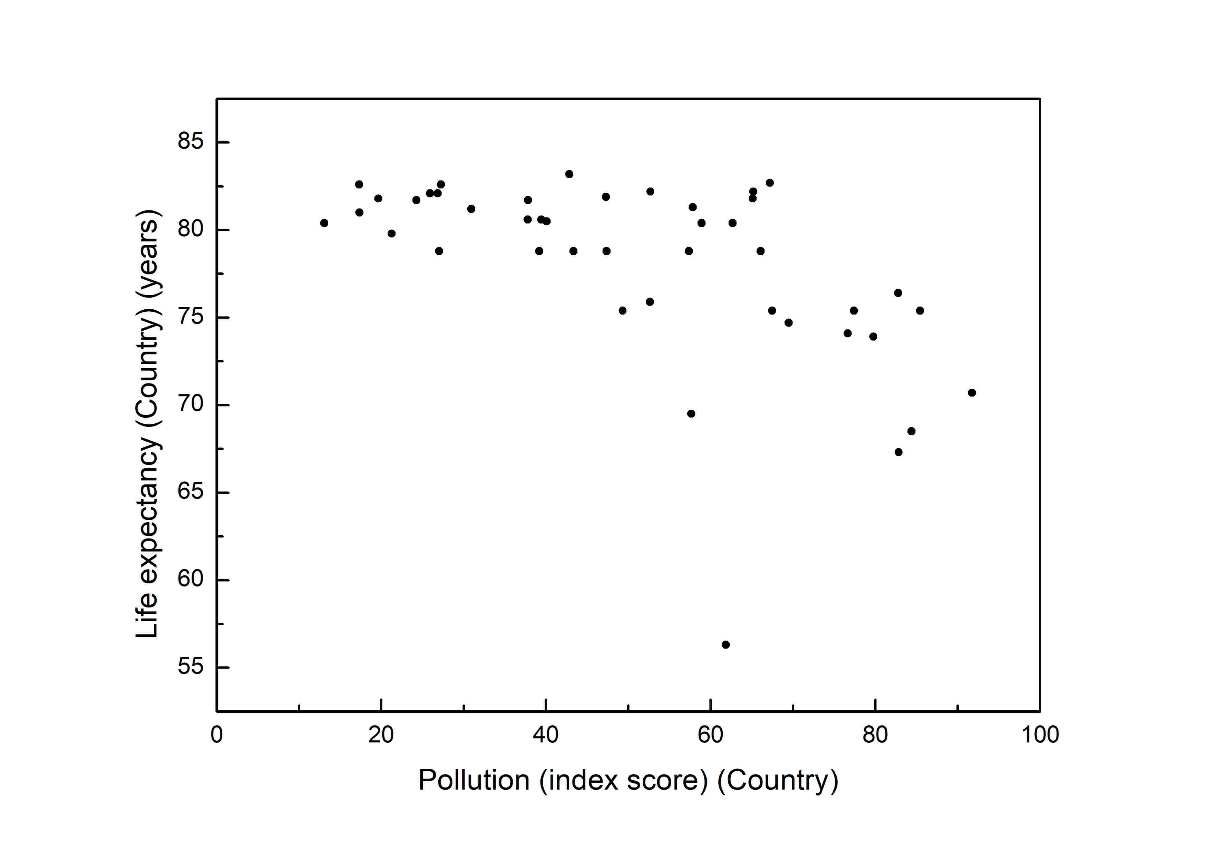
Pollution and life expectancy

Slide 30
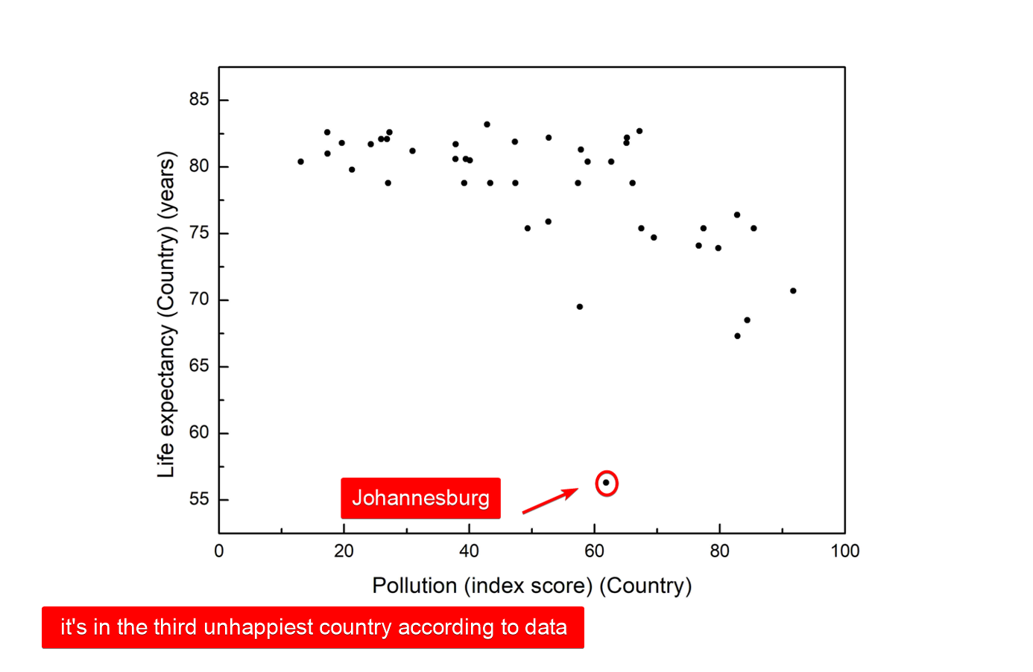

Slide 31
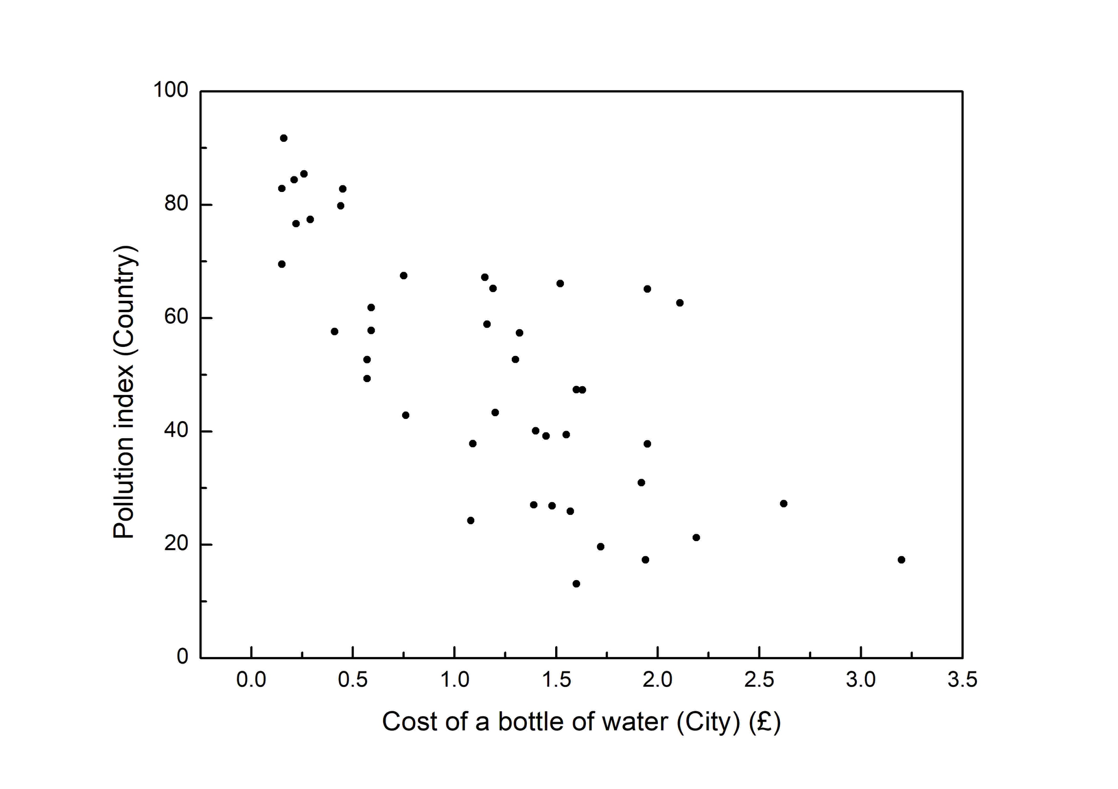
Assumption: the more expensive bottled water the better the standard of life, i.e. more developed country.

Slide 32
Conclusion: the better standard of life the less polluted the country. (Or maybe, more developed countries move their companies to countries that are less developed and will work for less money - cheap labor and thus countries with lower life standards are more polluted)

Slide 33
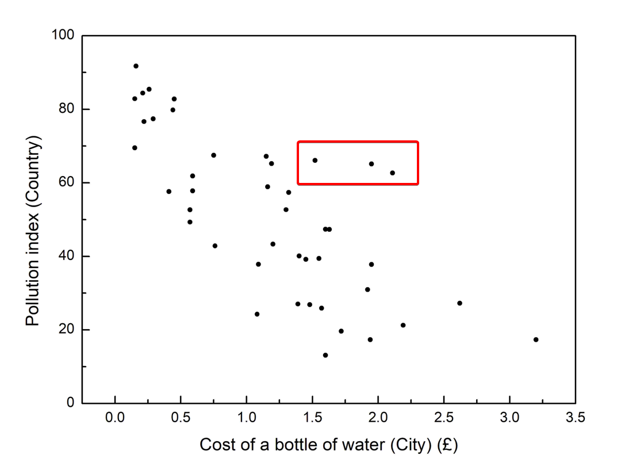
Points that somewhat deviate from previous graph:

Slide 34
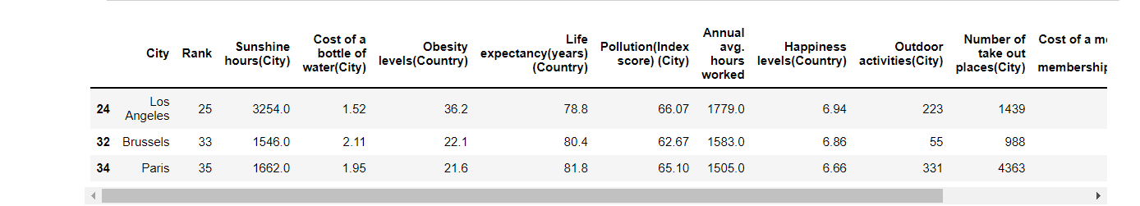

Slide 35
Amsterdam is ranked as #1 to live in.
#11 least polluted city
#16 by life expectancy
#5 happiest city
#3 by the number of outdoor activities

Slide 36
Trying to find equation for ranking the cities?

Slide 37
Thank you for your time!

